Slide 1
Introduction to Project Management
College of Computing and Information Technologies
Department of Information Technology

Slide 2
Objectives
At the end of the discussion, each students will be able to:
Understand the fundamentals of project management in the IT context
Identify key roles and responsibilities in IT projects
Recognize the function of PMI and the PMBOK Guide
Analyze common challenges in IT project management

Slide 3
Overview of Project Management and Its Relevance to IT
💡 What is Project Management?
“The application of knowledge, skills, tools, and techniques to project activities to meet project requirements.” – PMBOK, 7th Ed.
“Project management is a structured approach to planning, executing, monitoring, and closing temporary efforts to deliver a unique product or service .” Portny, 2020)

Slide 4
Overview of Project Management and Its Relevance to IT
[Cont..]
💻 Why is it Important in IT?
  IT projects involve complex technologies, tight deadlines, and limited budgets.
Examples:
  Developing a mobile banking app
  Migrating a university’s data to the cloud
  Implementing an enterprise resource planning (ERP) system

Slide 5
Overview of Project Management and Its Relevance to IT
[Cont..]
📌 IT-Specific Relevance
  High rate of tech project failures or overruns
  Need for adaptive planning (Agile, DevOps)
  Cross-functional team coordination

Slide 6
Roles and Responsibilities in IT Projects
Role | Description
Project Manager (PM) | Oversees scope, budget, timeline, risks, communication
System Analyst | Gathers requirements, analyzes feasibility
Developers/Programmers | Build and test software components
UI/UX Designers | Ensure intuitive user interfaces
QA Testers | Conduct functional and non-functional testing
Network/Infra Engineers | Handle deployment, hardware, and cloud
Stakeholders | Internal or external parties with project interest

Slide 7
Introduction to PMI and the PMBOK Guide
📘 What is PMI?
Project Management Institute (PMI) – Global non-profit that promotes best practices in project management.
Offers globally recognized certifications:
  PMP (Project Management Professional)
  CAPM (Certified Associate in Project Management)

Slide 8
Introduction to PMI and the PMBOK Guide
📗 What is PMBOK?
Project Management Body of Knowledge
A framework of standards, not a methodology
Key Performance Domains (7th Ed.):
Stakeholders
Team
Development Approach & Life Cycle
Planning
Project Work
Delivery
Measurement
Uncertainty
Example: A software company adopting Agile still uses PMBOK principles for risk tracking and stakeholder communication.

Slide 9
Challenges in IT Project Management
⚠️ Common Challenges Scope
  Creep – Requirements increase mid-project
  Poor Communication – Technical and business teams disconnect
  Unrealistic Deadlines – Misalignment of time and complexity
  Inadequate Risk Management – Ignoring security, compliance risks
  Technology Volatility – Rapid changes in frameworks, tools
💥 Real-World Example:
  A university ERP system failed due to lack of end-user consultation and rigid timelines, leading to cost overruns and low adoption.

Slide 10
Best Practices for IT PM Success
Define clear requirements early
Use hybrid or Agile methodologies
Emphasize stakeholder engagement
Perform regular risk reviews
Invest in communication and documentation tools

Slide 11
Summary
🔁 We covered:
The importance of project management in IT environments
Key roles and responsibilities within IT projects
The role of PMI and PMBOK in standardizing project work
Challenges and success factors in IT project delivery

Slide 12
Group Activity
💡 Activity: IT Project Team Composition:
Form groups of 4–5
Assign project roles (PM, Developer, Analyst, etc.)
Plan a sample IT project (e.g., Online Learning Platform)
Present a 2-minute role-based description of your responsibilities

Slide 13
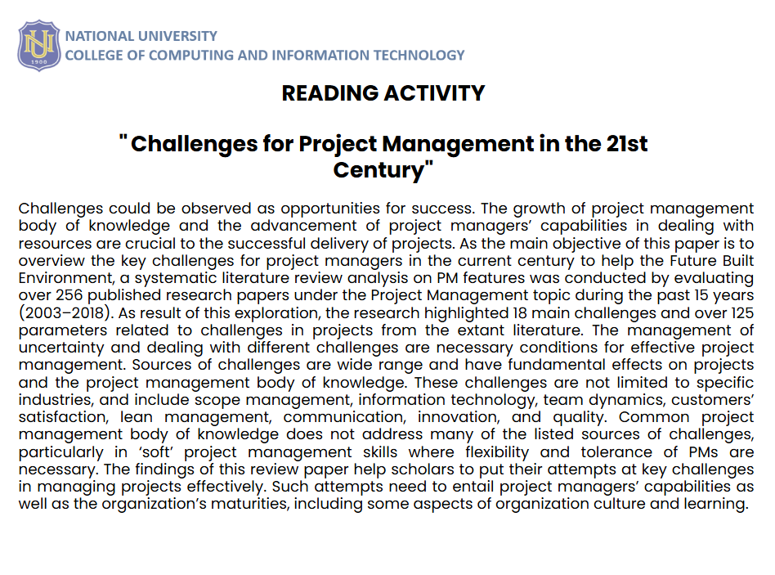
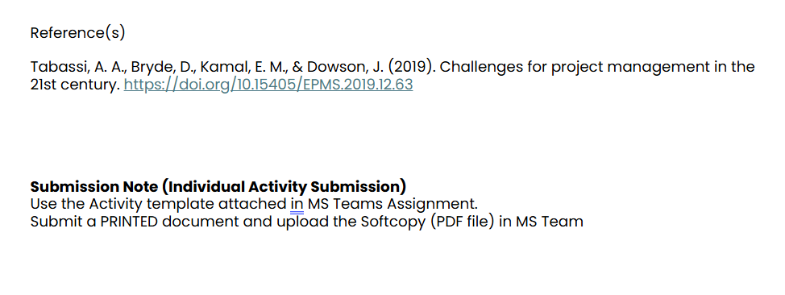
Individual Activity
How to answer this activity: Fill-out the template and follow each provided guide.
1. Understanding the Content
What are the main ideas or arguments presented in the journal? Discuss throughly.
2. Critical Analysis
Do you agree or disagree with the author’s perspective? Why?
3. Application and Relevance
*How does the reading relate to your own experiences, studies, or field of interest?
*Can the ideas or findings in the article be applied to real-world problems? If so, how?
*How might this reading influence your future learning or professional practice?
4. Personal Reflection
What did you learn about yourself or your own thinking from engaging with this reading?
5. Synthesis and Further Exploration
What questions do you still have after reading the article?
What additional research would you like to do based on this reading?

Slide 14
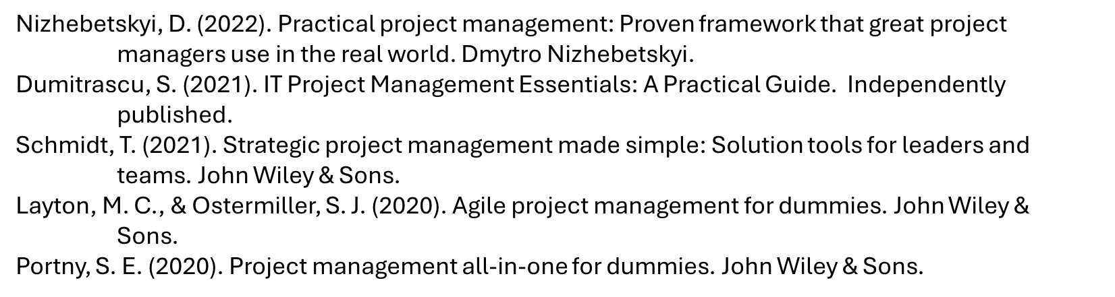
References

Slide 15
Thank you!

